Slide 1
Project 1 Mobile home Parkas as risk assesment in USA

Slide 2
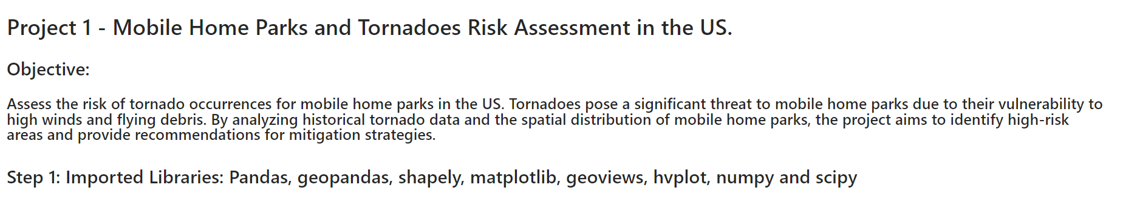

Slide 3
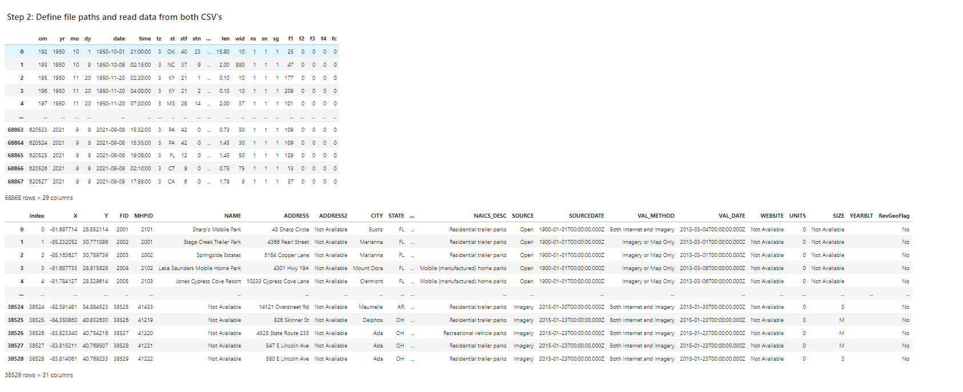

Slide 4
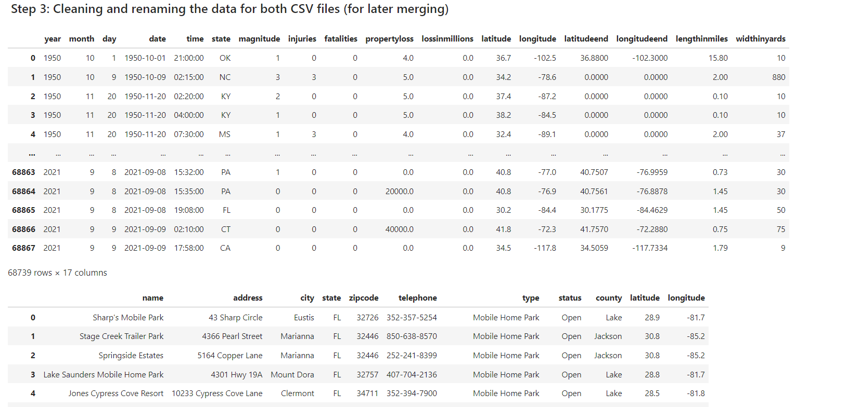

Slide 5
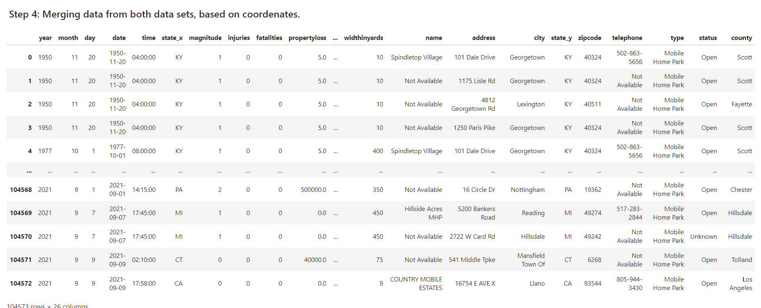

Slide 6
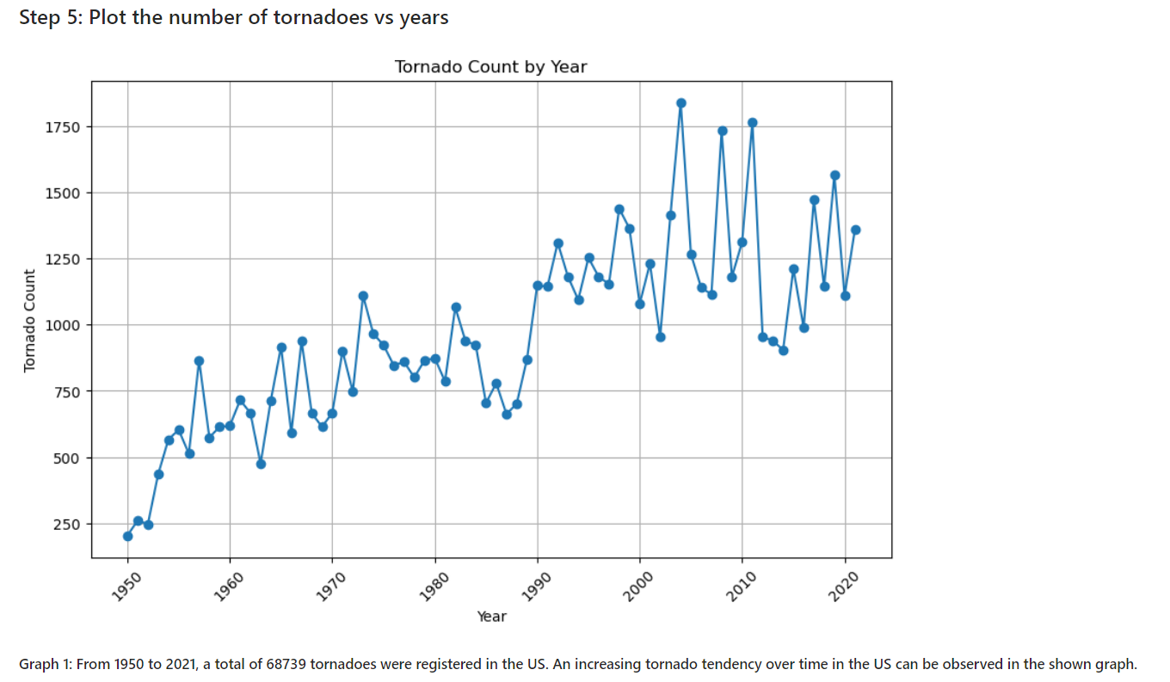

Slide 7
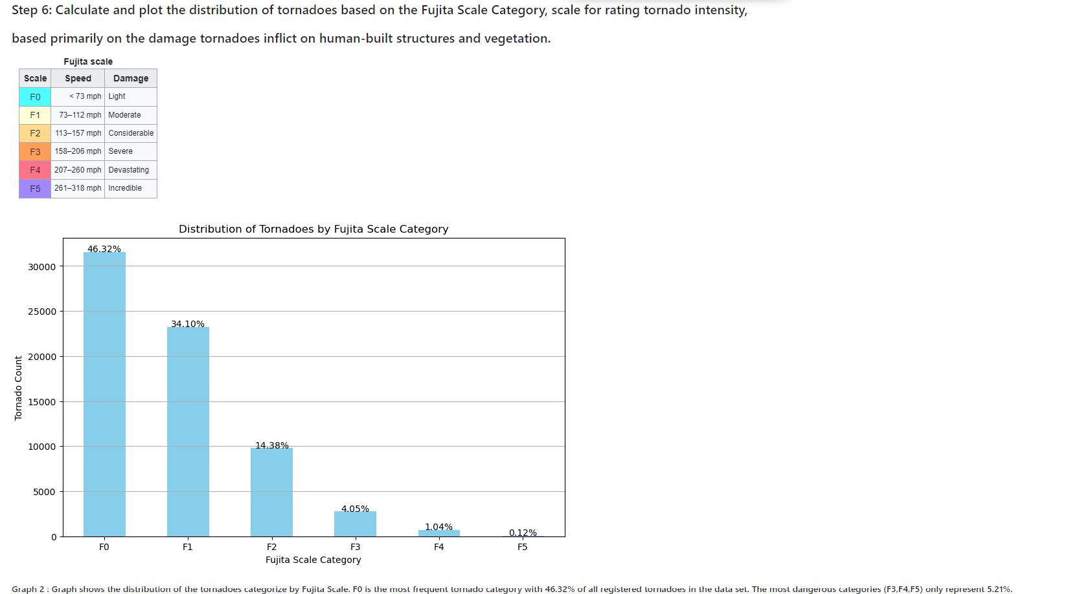

Slide 8
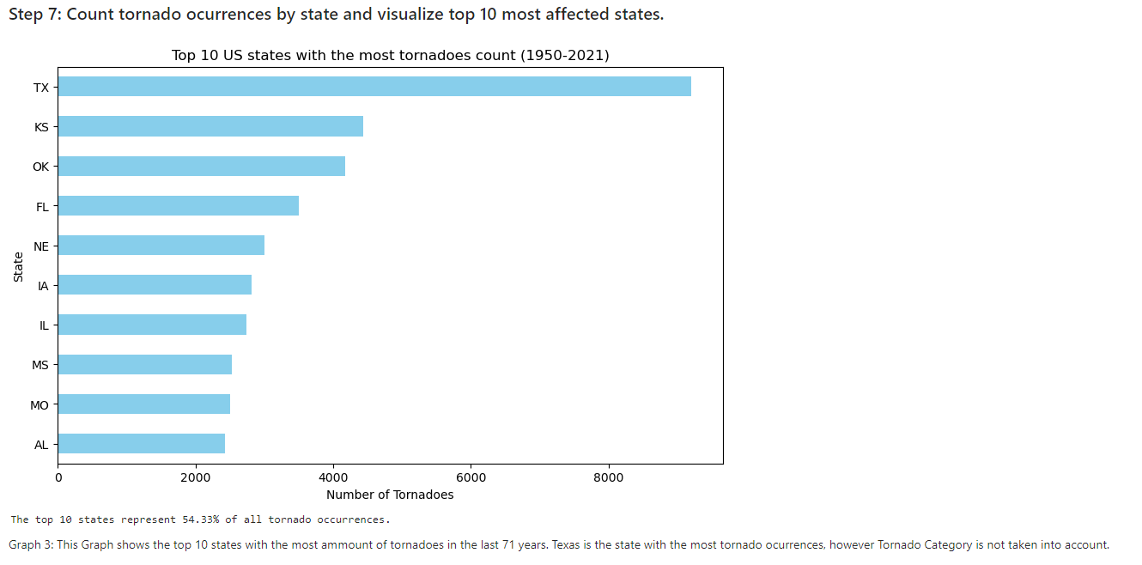

Slide 9
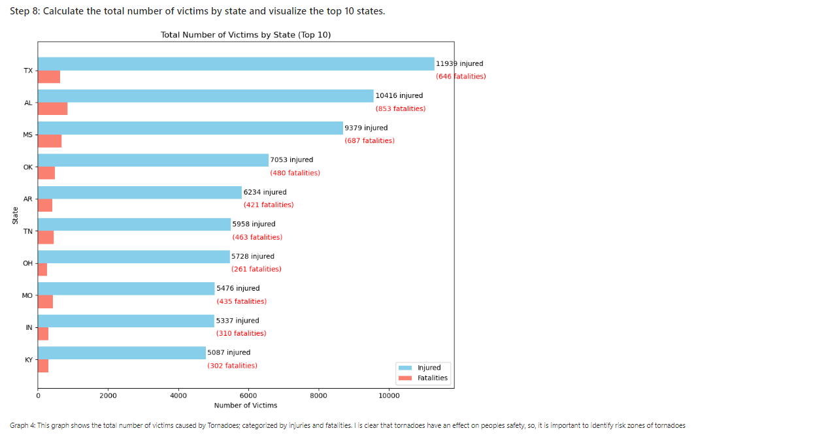

Slide 10
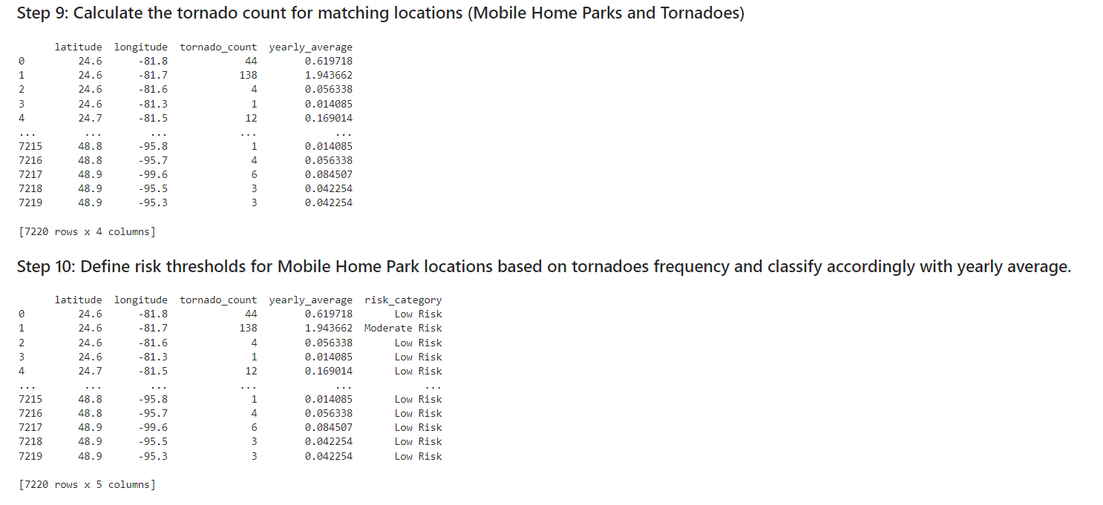

Slide 11
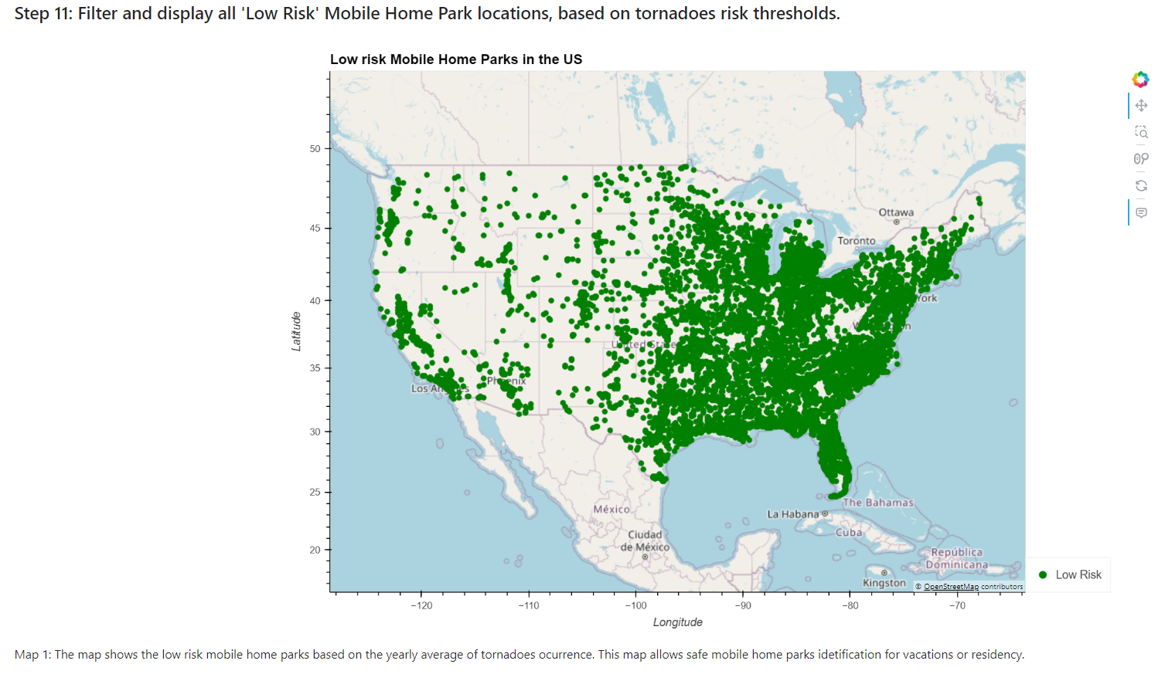

Slide 12
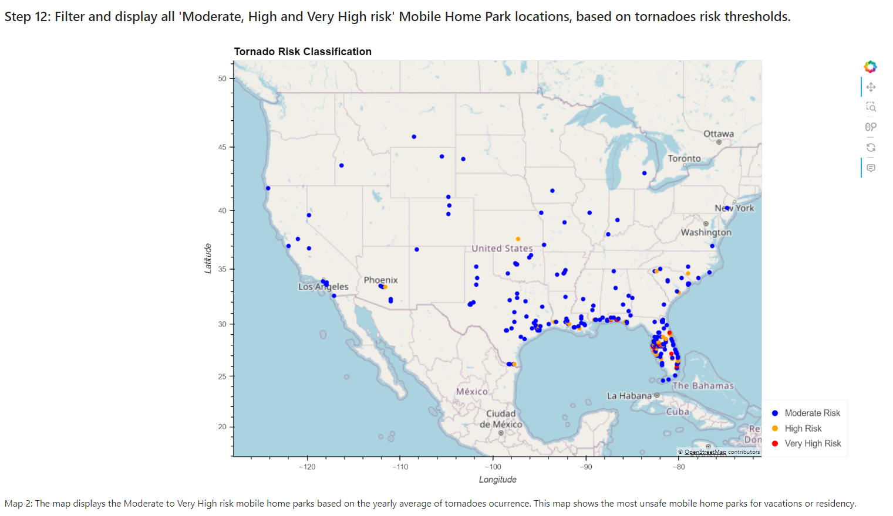

Slide 13
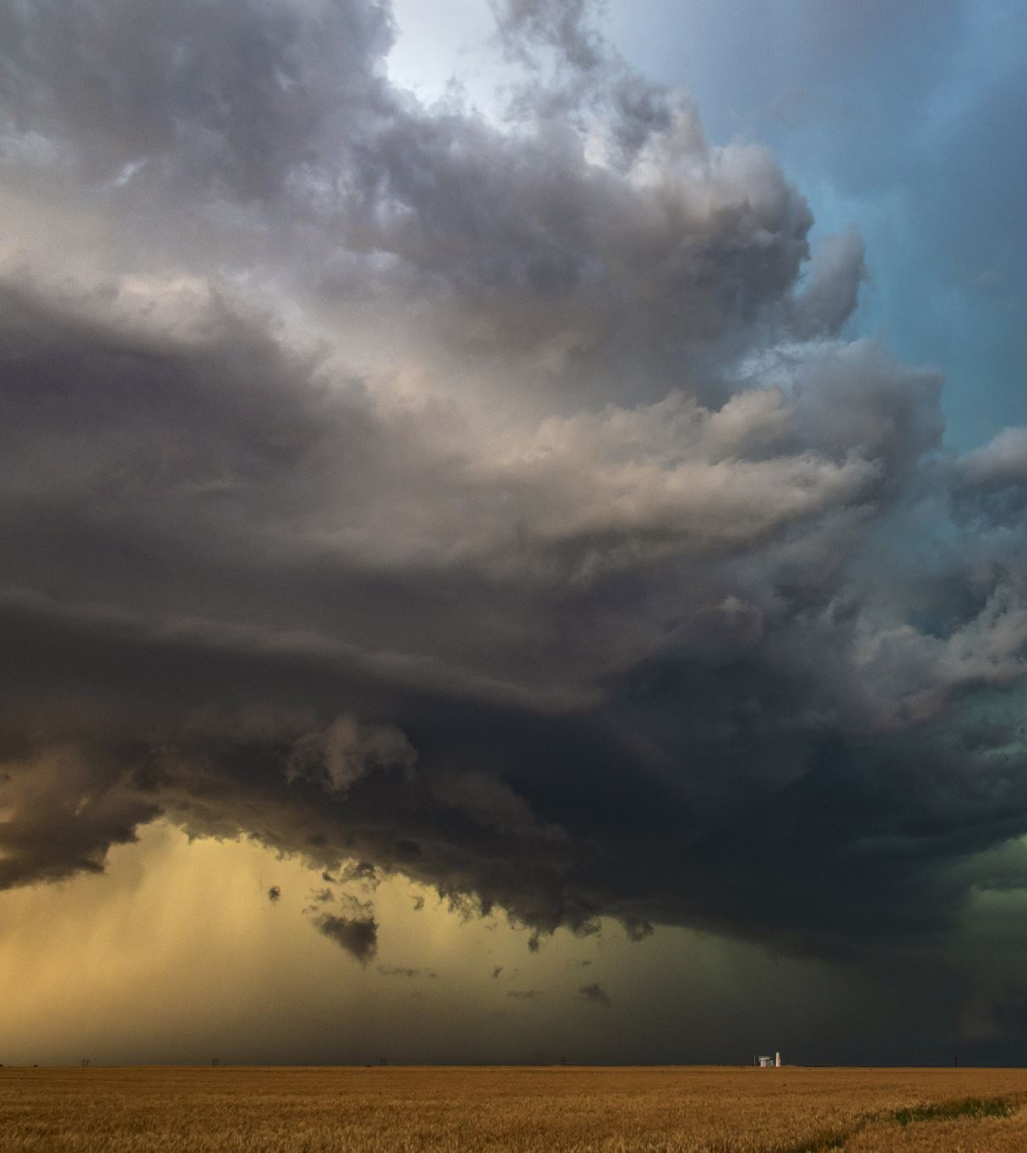
Conclusions and possible uses for this info.
1. There are numerous mobile home parks that are in a moderate to very high tornado ocurrance risk, even though most of them have a low-risk threshold.
2.- Florida is the state with the highest risk of experiencing a tornado according to the historical annual average.
3.- This data can be useful for government use for requesting resources against disasters and have contingency plans prepared.
4.- The data can help select an appropriate place to vacation or live in a mobile home.
5.- The data can also be used by insurers to offer insurance against natural disasters on high tornado risk sites.

